Slide 1
Intro to Development for non developers

Slide 2
Objective
Gain an understanding of:
What is a developer?
What is the stack?
Overview of the cloud?
What are programming languages?

Slide 3
What are developers?
Developers are people who solve technical problems by writing software.

Slide 4
What is a stack
The programming stack is a set of technologies that are used together to build software. Developers often use common sets of technologies that go together to build software.
You may hear terms like “LAMP Stack” or “Microsoft shop”
Notes:
Stacks can be mixed and matched, and this is happening more and more. Also, a single company can use several stacks.

Slide 5
The stack
User
You may hear terms like “Backend” or “Frontend” or “Full stack”
Front-End (UX)
Framework
Back end
Language
Database
Operating System
Sys Admin, Site reliability engineer Ops
Hardware

Slide 6
The stack
User
High Level
Front-End (UX)
Framework
Language
Database
Operating System
Hardware
Low Level
Notes:
None of the levels is more or less complex than the other
Low level just means that more levels are built on top of it.

Slide 7
The stack (confusing language)
High Level
“They understand the system at a very low level”
“I’m just trying to give you a very high-level view of the system”
This can be confusing
“He has a very high level of understanding”
Low Level
Notes:
Be careful of the language used around levels

Slide 8
Full stack
Full stack means both front and back end.
Most developers are full stack to some extent almost all developers can do some amount of both, but some are specialists.
The larger and more complex the project the more likely you are to have specialists.

Slide 9
Hardware
Servers, networks switches, wifi access points etc.
The technology everything is built on
What we build is useless without it

Slide 10

Hardware in the old days
A command executed in 2021
Hi we need a server for a new website
How many do you want
The business wants it live in one month.
Cloud Vender AWS/Azure
Developer
Notes:
That purchase order could have been for $10000 the process to get it commissions setup and to give the development team access could have taken 6 months. So much more forward planning was needed.
Companies where not agile.
Most developers these days wont ever see a production server. They won't know what it looks like. They also look a lot different to how they used to.
Companies like Dell and HP don’t sell many servers anymore and they don’t sell any to AWS and Azure and Google cloud.

Slide 11
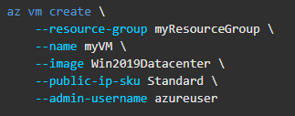
Hardware now
What you do in 2021
Notes:
This is a command any developer can run from there laptop now. Within maybe 3 minutes they will have a new “computer” in the cloud. This computer will cost them cents to run per minute.

Slide 12
Cloud Terms
You may hear terms like:
On Premises
A company's hardware they own/rent
IaaS
Infrastructure as a service: cloud provides you hardware, virtual computers
PaaS
Platform as a service: cloud hosts your application
SaaS
Software as a service: cloud hosts software you use (Gmail, Youtube)

Slide 13
What’s the difference
On Prem
IaaS
PaaS
SaaS
More Responsibility
More Control

Slide 14
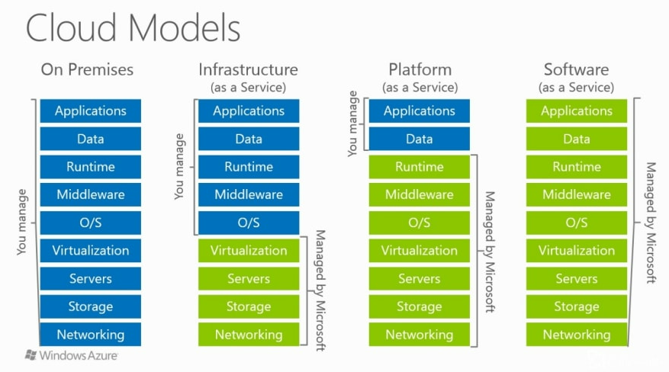

Slide 15
Operating System OS
There is not much to tell you about the OS you use it all the time
Window, MacOS
On your phone its Android and IOS
The world over servers is dominated by Linux
Most of you use Linux everyday in your phones
Most people don’t use Linux as a desktop OS
However, 95% of the servers in the world run some version of Linux
You may hear terms like “kernel” or “distribution”

Slide 16
Database
Every technology you use will be backed by a Database
It’s the core of any software business
Lose your data lose your business…
You may even have dedicated people just to look after your databases the DBA
Notes:
Classically there was a lot of tension between DBA and developers because developers wanted to get things done and create new features and DBA really where there to make sure we never lost data or the database never went down. Well that is a lot easier if it never changes.

Slide 17
Databases: SQL
MySQL, MS SQL Server, PostgreSQL, Oracle
Like a giant industrial spreadsheet
Very have been around for a very long time
Structured, mature, conservative popular
You may hear terms like “relational” or “RDBMS”
Notes:
SQL stands for structured query language, but no one ever says that.
From a skills point of view there is a lot of transfer between these technologies if you can do MySQL you can do 90% of oracle.

Slide 18
Database: No SQL
Redis, MongoDB, Elastic Search, DynamoDB, CosmosDB, CouchBase and many many more.
Store data more like folders on your laptop (just on a much bigger scale)
Flexible, newer, specialised, trendy
You may hear terms like “document” or “key-value”
Notes:
Its not a great name but it basically speaks to how dominate relational databases are that all the other types are grouped together into No SQL.
They have less structured usually you can store what you like, and this has pros and cons.
They can be very different from each other and not alike.
Skills with one will not always translate into skills with another.

Slide 19
Programming Languages
Ruby, C#, Python, Java, PHP, Go, C, C++, Erlang, Rust, Swift, Dart
Different languages do different jobs
Most companies and places use several languages
To be full stack you would probably need to know 5 “languages”
HTML, CSS -> Javascript -> Python -> SQL
Notes:
Why do we have so many programming languages, well because we can.

Slide 20
Why Programming Languages
Hello world in assembly.
org 0x100
mov dx, msg ; the address of or message in dx
mov ah, 9 ; ah=9 - "print string" sub-function
int 0x21 ; call dos services
mov ah, 0x4c ; "terminate program" sub-function
int 0x21 ; call dos services
msg db 'Hello, World!', 0x0d, 0x0a, '$' ; $-terminated message
Hello world in python
print("Hello, World!")
Notes:
All programming languages that developers use now are often called high level programming language this is because the language is not what run on your computer. It's converted into a lower-level language of some type that is close to what the machine will do. It cares about this like what bit of information is stored where in memory and it what exact order your CPU will need to run the instructions in.
These lower-level languages are a lot harder to write in or reason about so we came up with higher level languages and over time we have developed more and more for different reasons at different times.

Slide 21
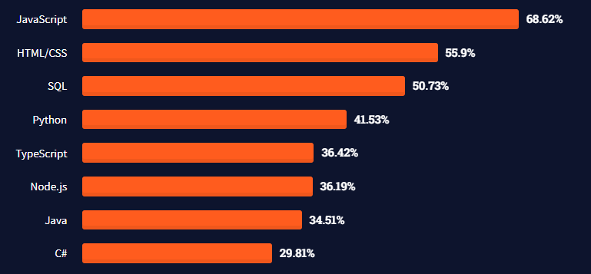
Some are more popular than others

Slide 22
Popular Languages: Java
Developed in the mid 90s by a company called Sun
It ran anywhere
Considered enterprise, it used it lots of large companies
Java is the language things like Play and Spring are frameworks
Original language for developing Android applications
You may hear terms like “JVM” or “Scala” or “Kotlin”
Notes:
At the time java came out it simplified a lot for developers, it could run anywhere windows, linux. At the time most developers wrote code in languages where they had to keep track of what was stored in memory where.

Slide 23
Popular Languages: C#
Developed by Microsoft as part of the .NET platform an answer to JAVA
Also often used by big enterprise companies
C# is the language asp.net is the framework
Stylistically similar to Java

Slide 24
Popular Languages JavaScript
By fare the most popular programming language in the world
Started out as only a front-end application it(in the browser) now its both front and back end (node js) and mobile devices (react native)
There are a million frameworks JQuery, Express, React, Vue, Angular
Flexible and dynamic, easy for beginner.
Evolved a lot in the last twenty years
Its popularity is not based on it being good
Notes:
It has nothing to do with Java its just has Java in the name because of marketing, Netscape in the 90s

Slide 25
Languages: Python
Good learning language, simple, popular
Python is the language, Django is a web framework
Flexible
The default language for data scientist.

Slide 26
Mobile Languages
For iOS = Objective C, Swift
Originally apps were built in Objective C
Swift is the new modern language for iOS
For Android = Java, Kotlin
Java was originally used but is now slowly being replaced by Kotlin which runs on the same underlying tech as Java
You can also write mobile application in Javascript, C# etc etc….
Notes:
The languages for iOS come from apple they created them and so it was for a while all you could use. Objective C is old and Swift is new.

Slide 27
Languages: Advanced/Hipster
Haskell, Scala, Rust, Go, Erlang, R, Elixiar, F#
Sometimes these languages have a specific use case or a community of developers just like them.

Slide 28
Frameworks
An optional but helpful template
Get you started faster
Increase productivity
Specific to the language e.g. Spring for Java asp.net for C#

Slide 29
Examples Stacks
An example stacks

Slide 30
Specializations
Front end
Back end
System administrator (aka SRE)
Devops
DBA
Data scientist

